Slide 1
Data analysis at HDFS

Slide 2
ssh localhost
hadoop namenode –format
start-all.sh
jps
sudo R

Slide 3
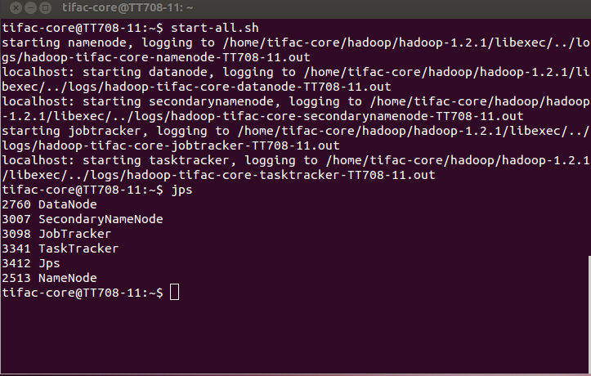

Slide 4
Sys.setenv(HADOOP_HOME="/home/tifac-core/hadoop/hadoop-1.2.1")
Sys.setenv(HADOOP_CMD="/home/tifac-core/hadoop/hadoop-1.2.1/bin/hadoop")
library(rmr2)
library(rhdfs)
ints = to.dfs(1:5)
calc = mapreduce(input = ints,
map = function(., v) cbind(v, 2*v))
# map = function(., v) mean(v))
# map = function(., v) sum(v))
# map = function(., v) sd(v))
rs= from.dfs(calc)
print(rs)

Slide 5
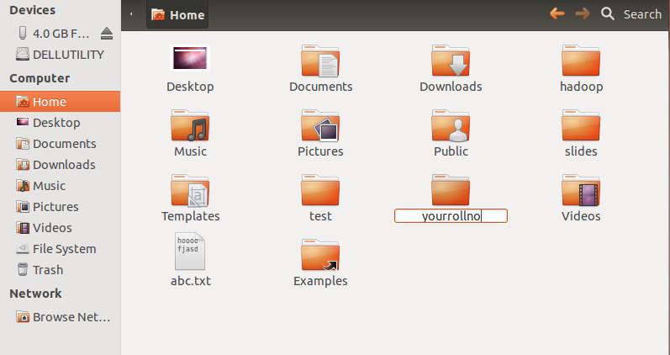
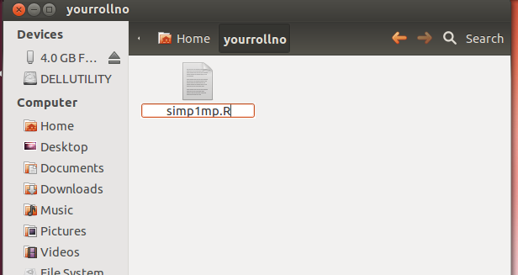

Slide 6
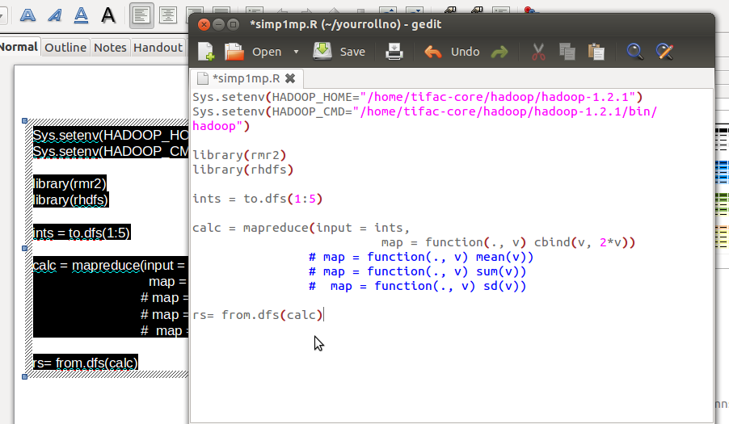

Slide 7
sudo R
source(“yourrollno/simp1mp.R”)

Slide 8
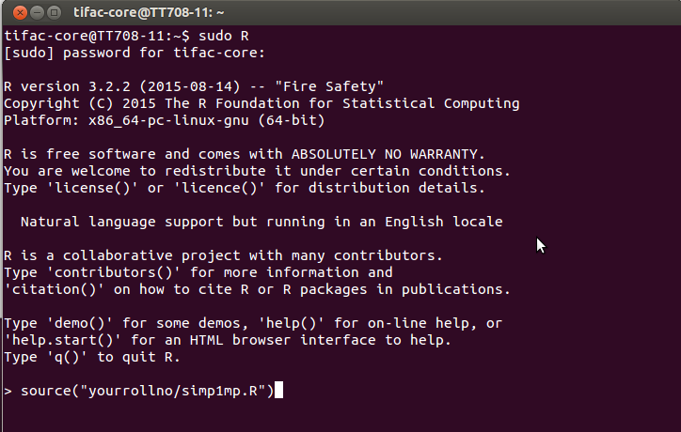

Slide 9
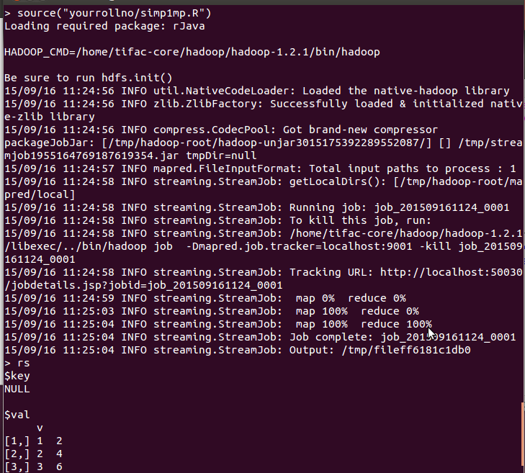

Slide 10
Sys.setenv(HADOOP_HOME="/home/tifac-core/hadoop/hadoop-1.2.1")
Sys.setenv(HADOOP_CMD="/home/tifac-core/hadoop/hadoop-1.2.1/bin/hadoop")
library(rmr2)
library(rhdfs)
grs = to.dfs(c(10,2,6,10,4,12,2,10,4,6))
ab=mapreduce(
input = grs,
map = function(., v) keyval(v, 1),
reduce =function(k, vv) keyval(k, length(vv)))
mrs=from.dfs(ab)
print(mrs)

Slide 11
Sys.setenv(HADOOP_HOME="/home/tifac-core/hadoop/hadoop-1.2.1")
Sys.setenv(HADOOP_CMD="/home/tifac-core/hadoop/hadoop-1.2.1/bin/hadoop")
library(rmr2)
library(rhdfs)
ints = to.dfs(1:500000)
calc = mapreduce(input = ints,
map = function(., v) keyval(1,v),
reduce=function(k,v) keyval(k,mean(v)))
#reduce=function(k,v) keyval(k,sd(v)))
#reduce=function(k,v) keyval(k,sum(as.numeric(v))))
rs= from.dfs(calc)
print(rs)

Slide 12
Sys.setenv(HADOOP_HOME="/home/tifac-core/hadoop/hadoop-1.2.1")
Sys.setenv(HADOOP_CMD="/home/tifac-core/hadoop/hadoop-1.2.1/bin/hadoop")
library(rmr2)
library(rhdfs)
mystr=to.dfs("hai how are you where are you")
abc=from.dfs(
mapreduce(
input = mystr,
map = function(., v) keyval(unlist(strsplit(v,split = " ")),1),
reduce = function(k, vv) keyval(k, sum(vv))
)
)
print(abc)

Slide 13
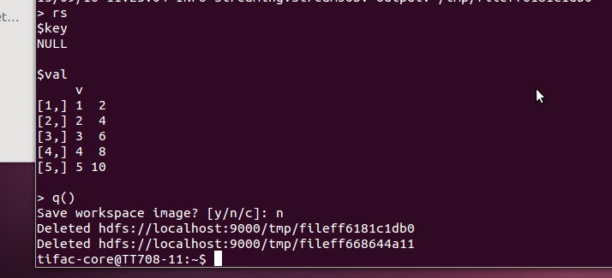
q()

Slide 14
Sys.setenv(HADOOP_HOME="/home/tifac-core/hadoop/hadoop-1.2.1")
Sys.setenv(HADOOP_CMD="/home/tifac-core/hadoop/hadoop-1.2.1/bin/hadoop")
library(rmr2)
library(rhdfs)
wordcount = function(input, output = NULL, pattern = " "){
mp = function(., lines) {
keyval(unlist(strsplit(lines, split = pattern)), 1)
}
rd = function(word, counts ) {
keyval(word, sum(counts))
}
mapreduce(
input = input ,
output = output,
input.format = "text",
map = mp,
reduce = rd)
}

Slide 15
hadoop dfs -mkdir tifac
hadoop dfs -put abc.txt /user/tifac-core/tifac
sudo R
source(“yourrollno/simp1mp.R”)
rs=wordcount(“/user/tifac-core/tifac/abc.txt”)
from.dfs(rs)

Slide 16
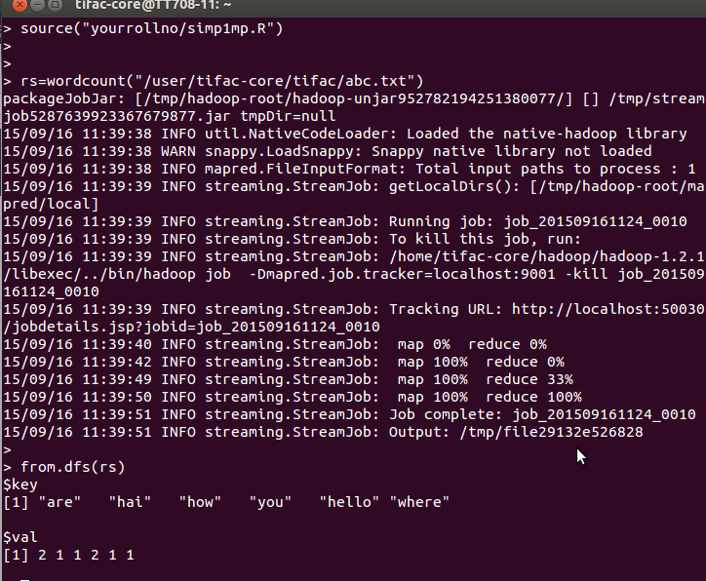

Slide 17
Sys.setenv(HADOOP_HOME="/home/tifac-core/hadoop/hadoop-1.2.1")
Sys.setenv(HADOOP_CMD="/home/tifac-core/hadoop/hadoop-1.2.1/bin/hadoop")
library(rmr2)
library(rhdfs)
stockmean = function(input, output = NULL, pattern = " "){
wc.map <- function(.,v) {
fields <- unlist(strsplit(v, ","))
keyval(fields[1], mean(as.double(c(fields[3], fields[6]))))
}
wc.reduce <- function(k,vv) {
keyval(k, mean(as.numeric(unlist(vv))))
}
mapreduce(
input = input ,
output = output,
input.format = "text",
map = wc.map,
reduce = wc.reduce,
combine = T) }

Slide 18
q()

Slide 19
hadoop dfs -put /home/tifac-core/slides/stocks.txt /user/tifac-core/tifac
sudo R
source(“yourrollno/simp1mp.R”)
st=stockmean(“/user/tifac-core/tifac/stocks.txt”)
from.dfs(st)

Slide 20
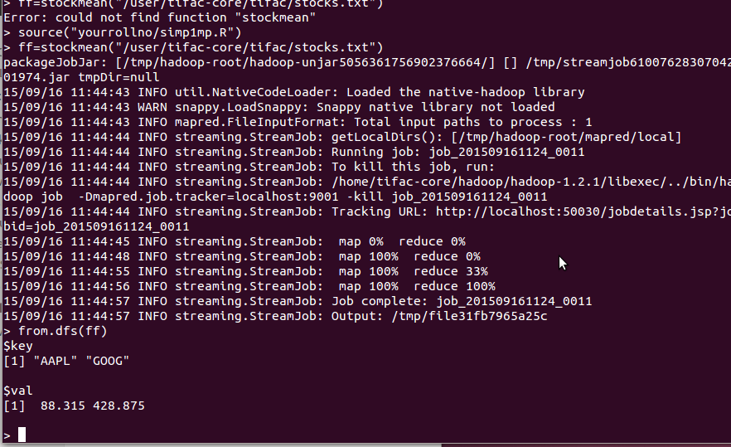

Slide 21
q()
hadoop dfs –rmr /user
hadoop dfs –rmr /tmp
stop-all.sh
jps
exit

